Slide 1
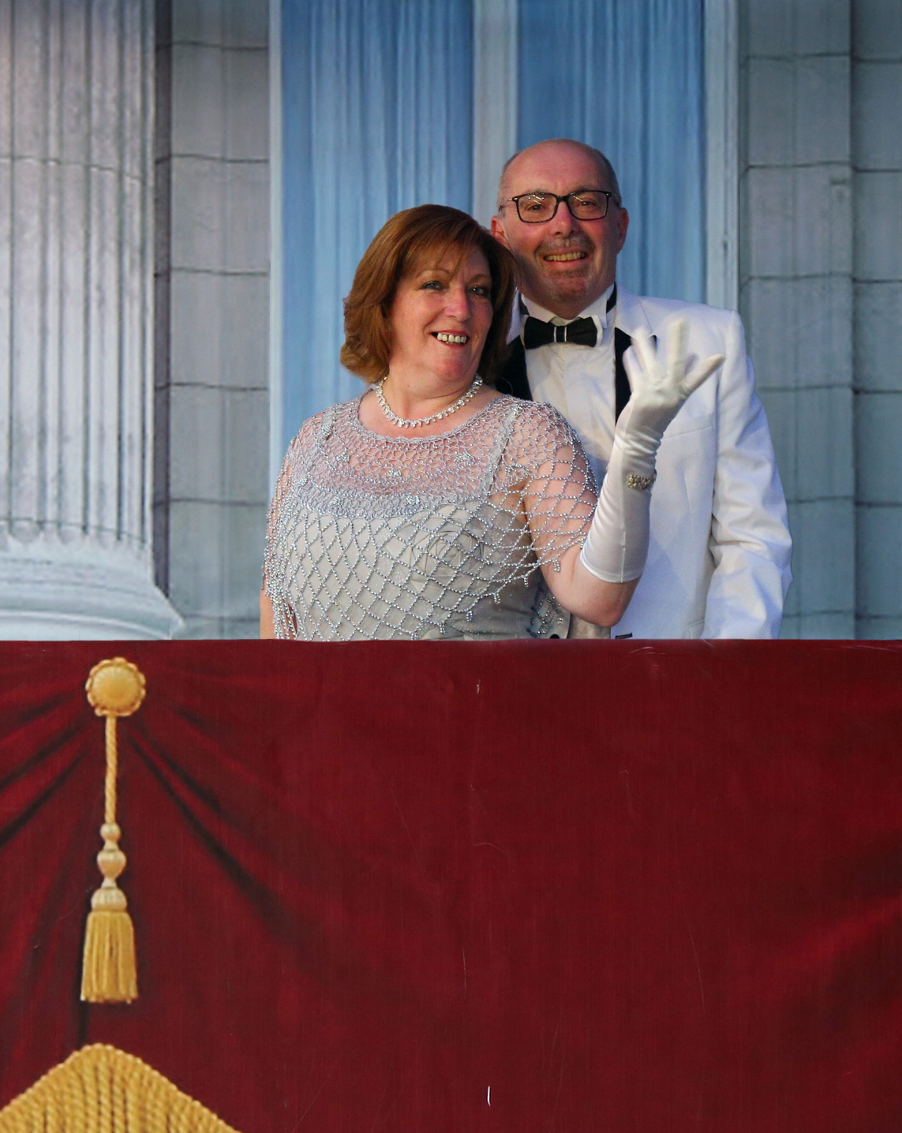

Annual General Meeting 5 March 2018

Slide 2
Agenda
Welcome and introduction – Andy Coy, Acting Chairman
Approval of 2016 Minutes and Financials – Andy Coy, Acting Chairman
Review of 2017 – Andy Coy, Acting Chairman
Financial Report 2017 – Andy Coy, 2017 Treasurer
Constitution Amendment Proposal: Vote by show of Hands – David Alexander, Deputy Chairman
Membership Introductory Benefit: Vote by show of hands – David Perrins, Business Development
Address by other 2018 Board members:
John Thorne – Treasurer and Survey
Rob Wood – Social and Communications
Khalid Al-Rasheed – Saudi Consultant
Andrew Elliott – Special Briefings
Sarah-Jane Agier – Business Manager
Overview of RGBB survey – Andy Coy, Chairman
Any Other Business

Slide 3
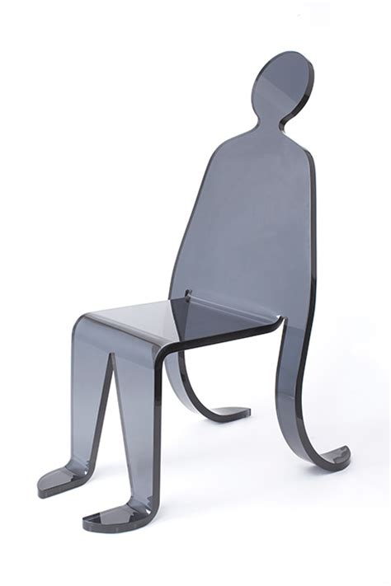
Chairman’s Review
Andy Coy

Slide 4
Our achievements
Closer alignment with our sponsors in the Department for International Trade (DIT)
Paul Hardy –
Steve Graham
Implementation of industry focused groups within the RGBB
First Survey
Implementation of RGBB website

Slide 5
Events since 6 March 2017 AGM…
Type of Event | Attendees (approx.)
DIT / Embassy Executive Briefing (SABIC) | 120
1 Business Networking Evening | 120
8 Special Briefings | 800
2 Balls | 620
1 Horse Racing | 120
1 Quiz Night | 100
14 Events | 1 880

Slide 6

Financial Report for 2017
Andy Coy – Treasurer for 2017

Slide 7
Income / Expenditure Statement 2017

Slide 8
Statement of Net Assets 2017 - 2018

Slide 9

Constitution Amendment Proposal
David Alexander - Deputy Chairman
Vote by Show of Hands

Slide 10

Membership Introductory Benefit
David Perrins – Business Development

Slide 11
Membership Introductory Benefit
A number of routes for raising awareness and increasing membership of the RGBB
Refer a colleague:
Existing members invited to refer a colleague to join the RGBB
50SAR discount per referral on annual membership renewal
Maximum of four referrals per year, up to 200SAR discount
Ready to launch upon members’ agreement

Slide 12

Address by other 2018 Board Members

Slide 13
2018 Upcoming events…
Date | Event
19 March | Special Briefing: what3words
16 April | Special Briefing
30 April | Special Briefing
10 May | Summer Ball : A Royal Wedding
4 June | Special Briefing
17 September | Networking Evening
3 October | Social Event
15 October | Special Briefing
5 November | Special Briefing
26 November | Special Briefing
6 December | Winter Ball

Slide 14

2017 Survey Overview

